Slide 1

Convolutional Neural Networks
Computer vision
deeplearning.ai

Slide 2
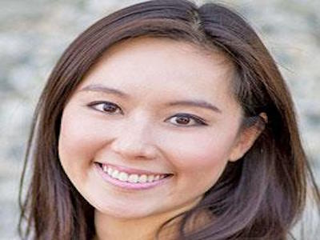
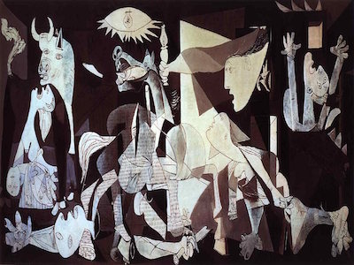
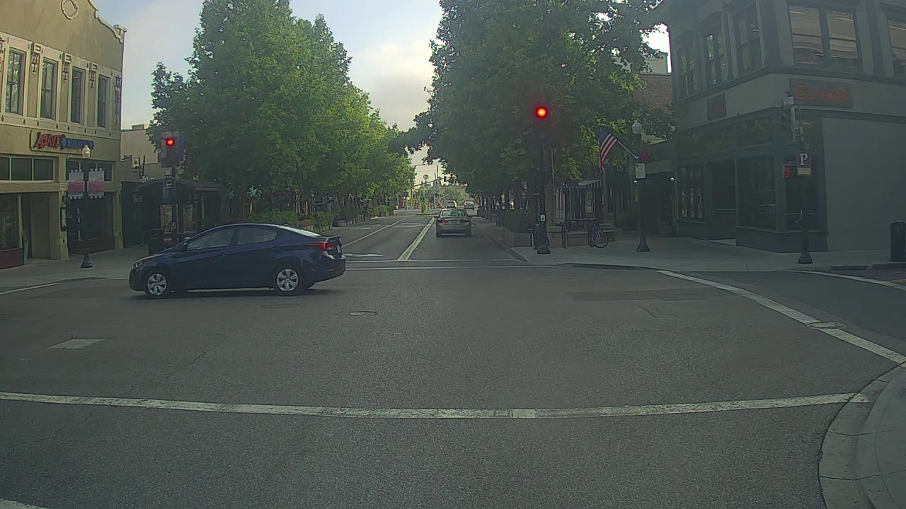
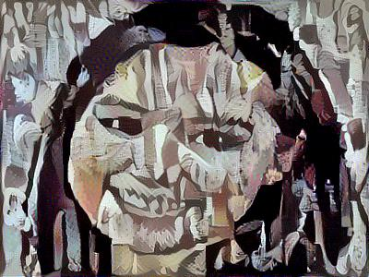
Computer Vision Problems
Image Classification
Neural Style Transfer
Cat? (0/1)
64x64
Object detection

Slide 3

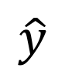
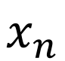
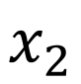
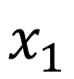

Deep Learning on large images
大图像，输入变量X的维数很高，需要计算的参数变量也会很多，带来计算问题和数据不够问题
Cat? (0/1)
64x64
$$x_{1}$$
$$x_{2}$$
$$⋮$$
$$⋮$$
$$⋮$$
$$\hat{y}$$
$$x_{n}$$

